Slide 1
Namma Yatri – Business Insights

Slide 2
agenda
Core Focus Areas: Enhance customer experience Maximize revenue per ride Optimize fleet utilization and availability Improve app funnel conversions

Slide 3
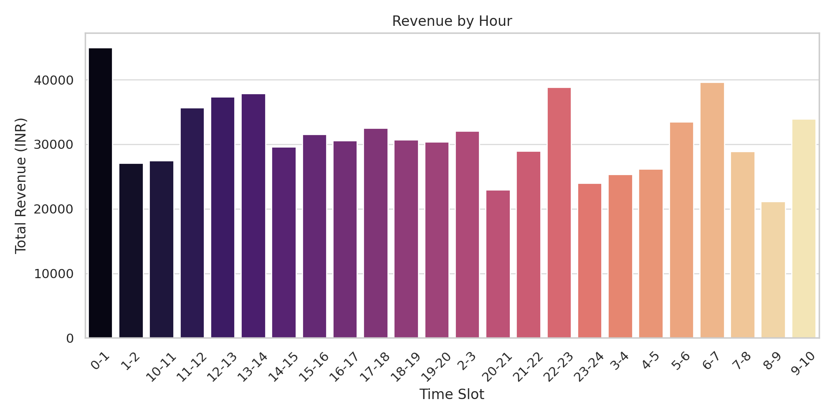
Peak Demand Hours
Insight:
9–11 AM and 6–8 PM have highest ride volume
Strong alignment with commute behavior
Action:
Prioritize driver incentives and availability in these hours

Slide 4
Top Revenue Periods
Revenue aligns with ride demand
Action: Implement surge pricing or reward-based schemes

Slide 5
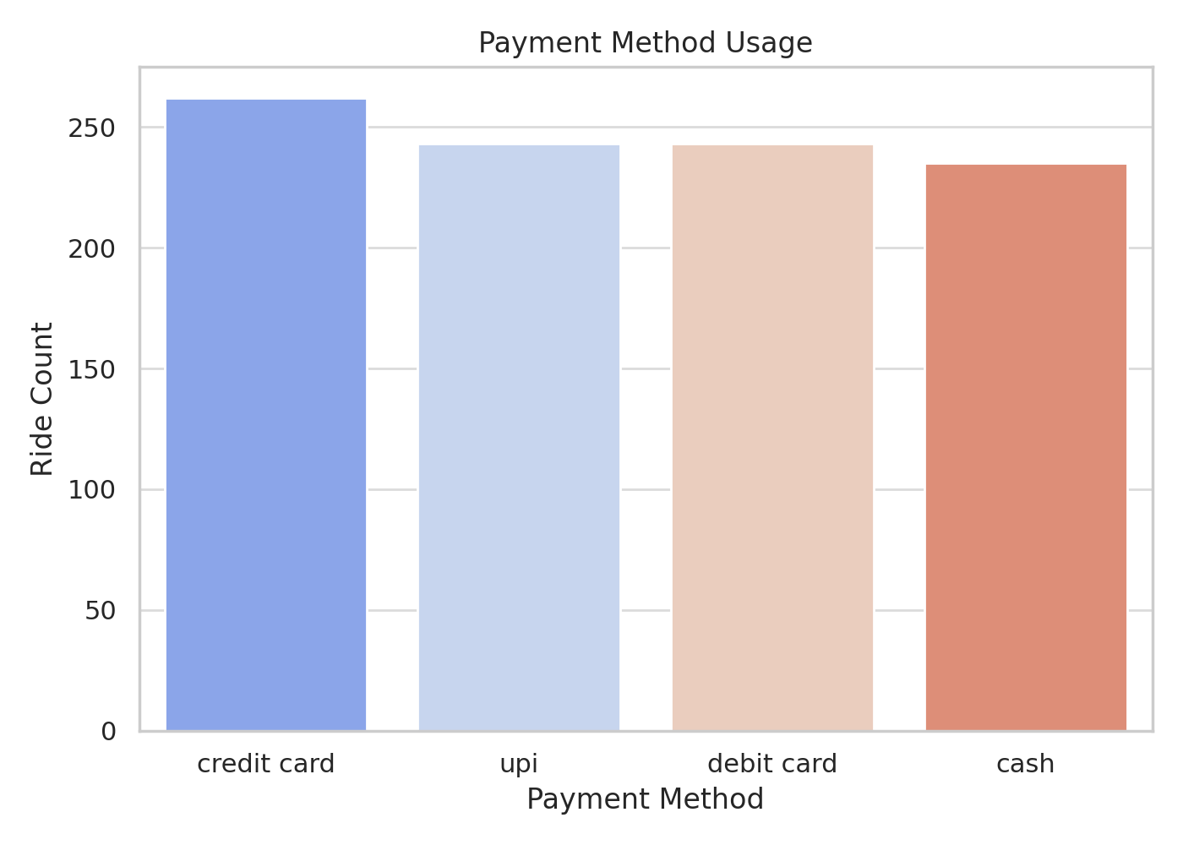
Preferred Payment Methods
Evenly distributed across Credit Card, UPI, Debit, and Cash
⚠ Likely synthetic data; real usage favors UPI and Cash
Action: Promote digital payments via cashback offers

Slide 6
Top Performing Zones
Zones with highest ride count also generate most revenue
Action: Target marketing and driver placement in these areas

Slide 7
Cancellations Overview
Slightly higher cancellations from customers
Action: Improve ETA estimates and rematching reliability

Slide 8
Booking Funnel Drop-offs
Drop after price quote stage indicates user hesitation
Action: Simplify UX, offer quote locks or loyalty discounts

Slide 9
Conversion Trends by Hour
Late-night hours show lower completion rates
Action: Provide night-time driver incentives and safety badges

Slide 10
Strategic Recommendations
Align supply with peak demand using real-time data
Promote UPI usage via rewards and seamless integration
Optimize quote-to-booking funnel via behavioral nudges

Slide 11
Conclusion
Data reveals clearly actionable strategies
Geo-targeting, price tuning, and UX improvements can drive growth

Slide 12
thank you
Sanjana Tadem

